Slide 1
MIS547
Cloud Computing

Slide 2
Lecture 2: WHAT IS COMPUTING

Slide 3
What is Computing?
Computing comprises computer hardware, use of computer applications, and development of computer software.
“In a general way, we can define computing to mean any goal-oriented activity requiring, benefiting from, or creating computers”
- Joint committee of ACM, IEE, and AIS

Slide 4
What is Computing: Compute Resources
Compute resources are measurable quantities of compute power that can be requested, allocated, and consumed for computing activities.

Slide 5
What is Computing?
CPU
Memory
Storage
Network
GPU
Compute Resources
Compute is a generic term used to reference processing power, memory, network, storage, and other resources required for the computational success of any program.

Slide 6
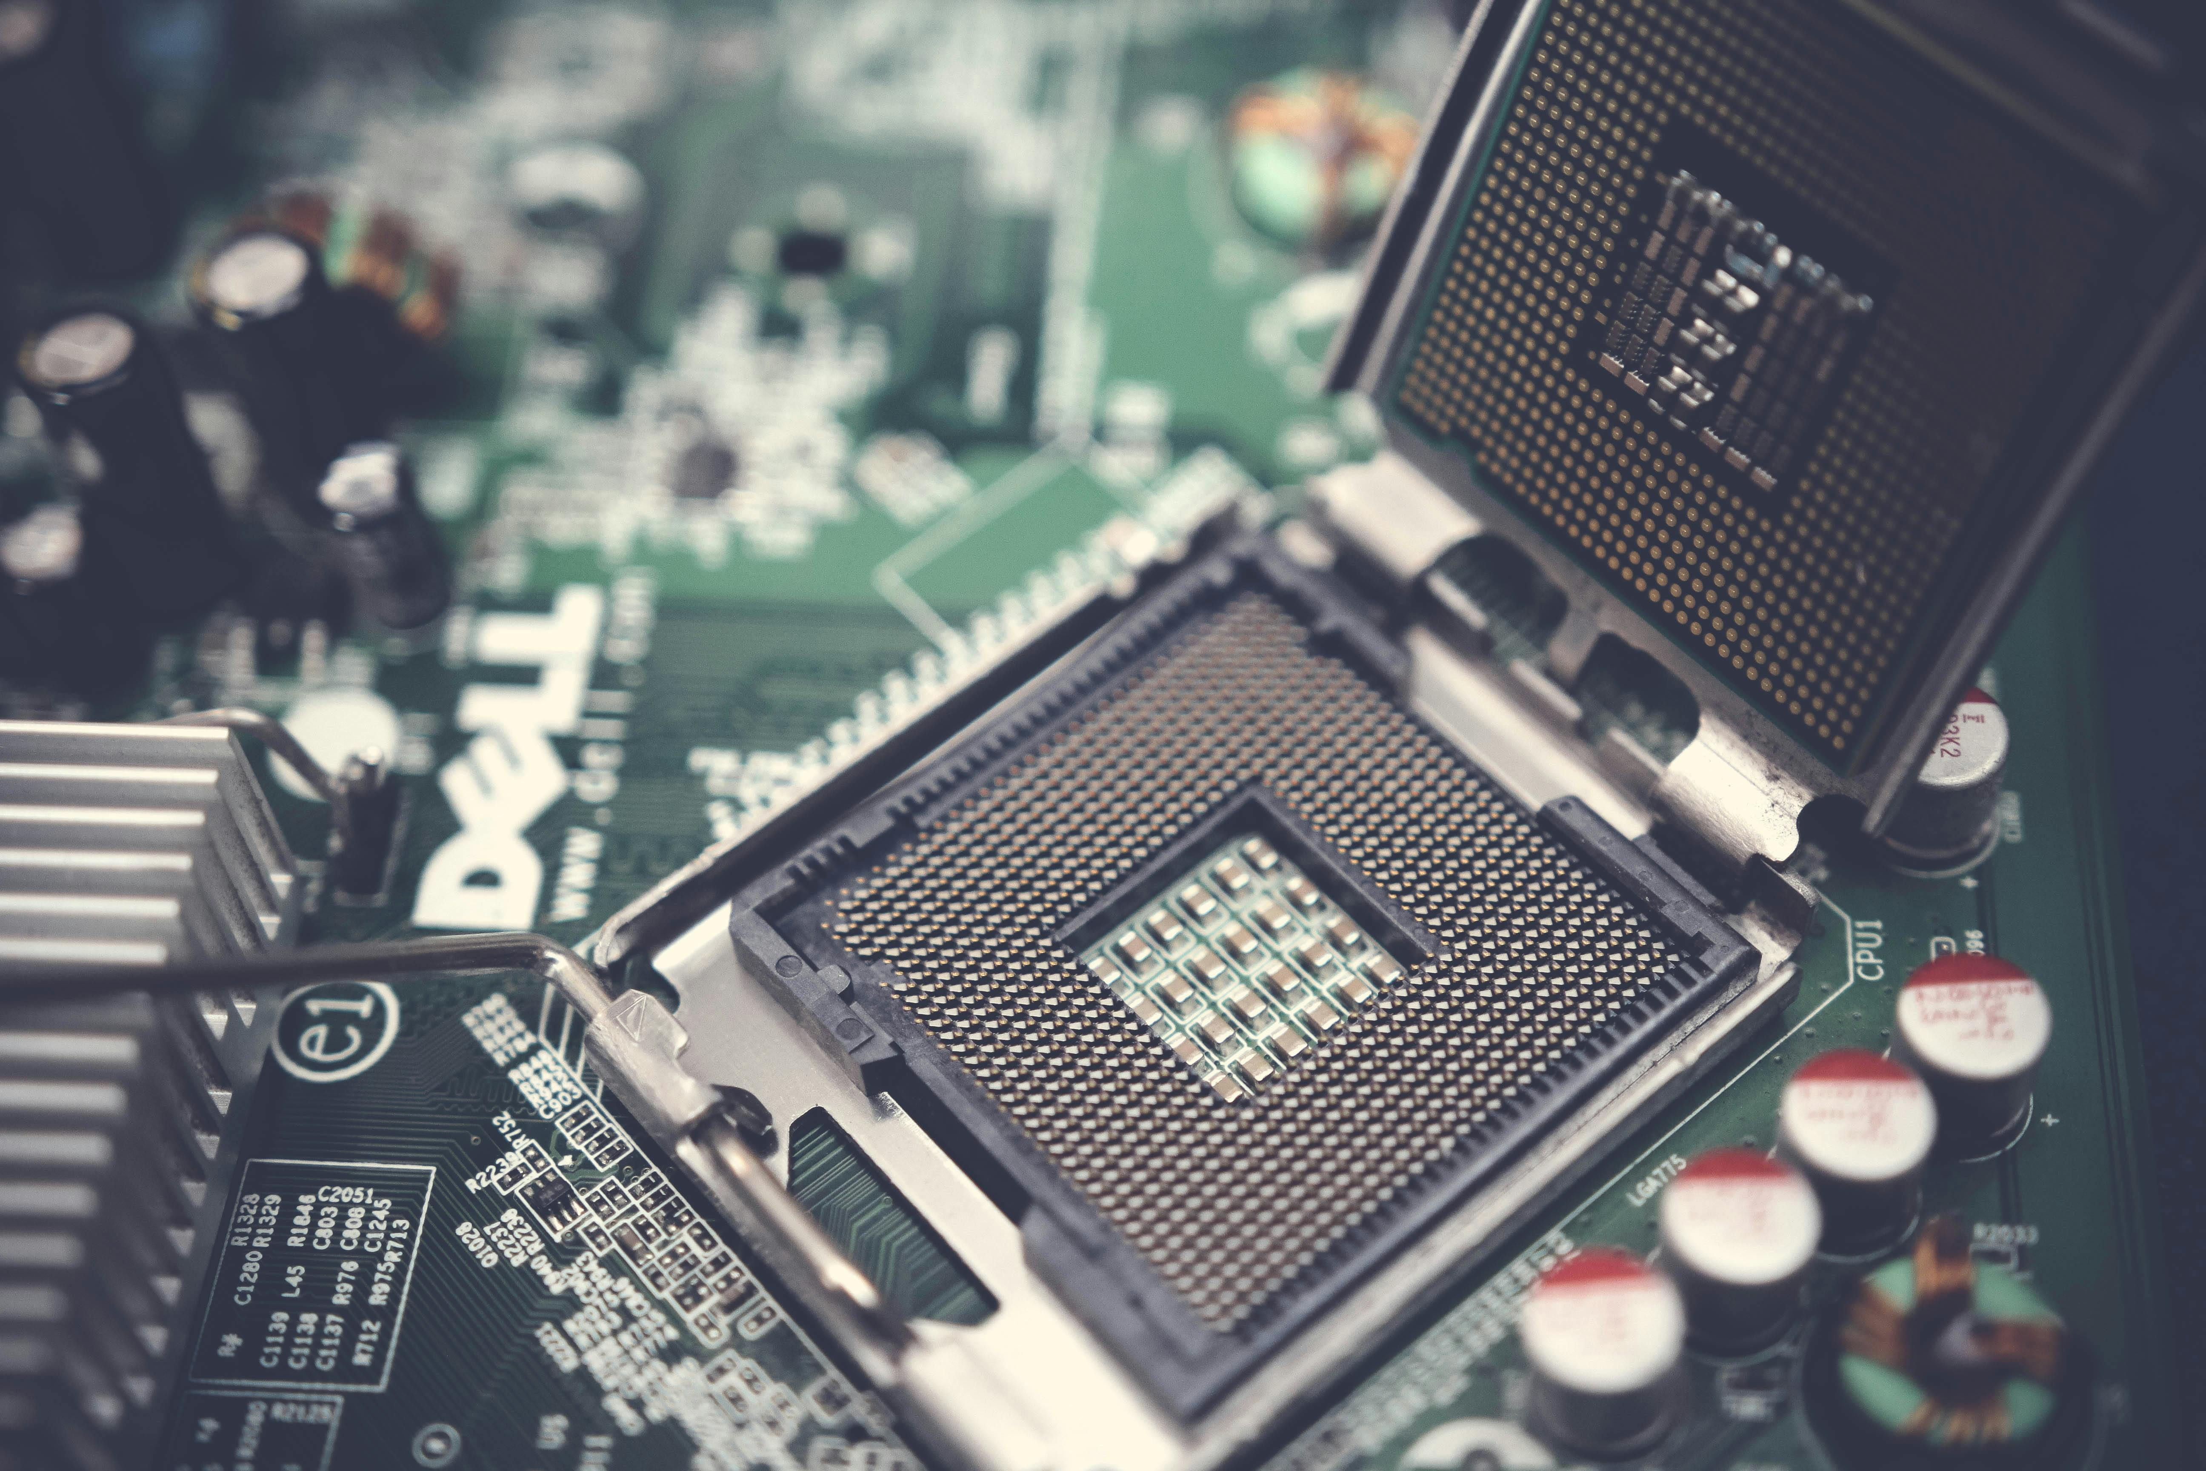
Central Processing Unit (CPU)
In charge of all computation.
First mass-produced CPU was the Intel 4004
Late 1960s
Italian physicist and engineer named Federico Faggin
4-bit architecture (as opposed to 64 bit that we use today)

Slide 7
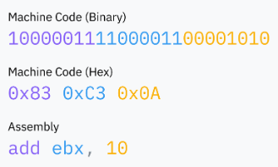
Central Processing Unit: CPU
Assembly:
Helpful syntax for reading and writing machine code that’s easier for humans to read than binary
Machine code:
Series of these binary instructions in a row
Instructions that a CPU executes are binary data
1-2 bytes to represent what instruction is being run (the opcode), followed by whatever data is needed to run the instruction.
Assembly
Machine code
Binary
CPU

Slide 8
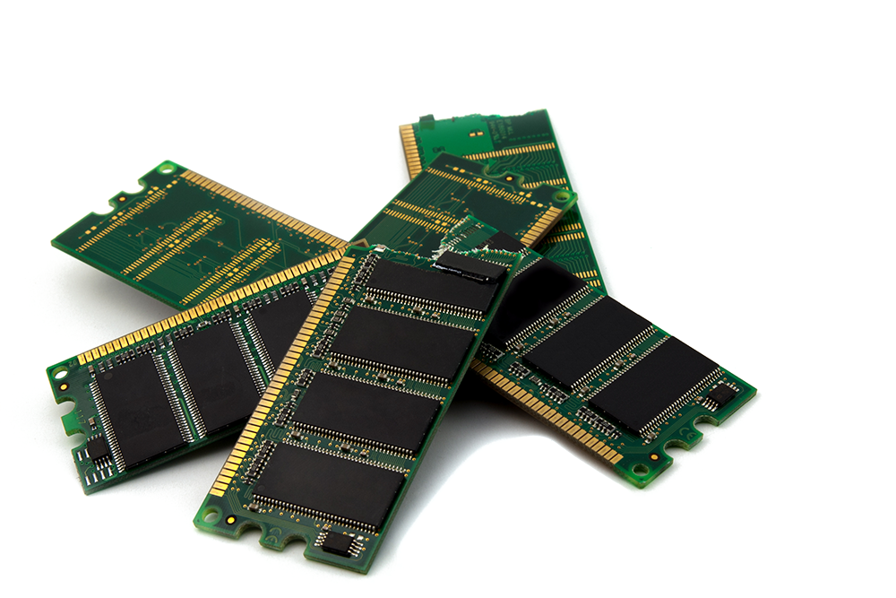
Random Access Memory (RAM)
Computer’s main memory bank
Large multi-purpose space which stores all the data used by programs running on your computer.
Includes the program itself, as well as the code at the core of the OS
This Photo by Unknown Author is licensed under CC BY-NC

Slide 9
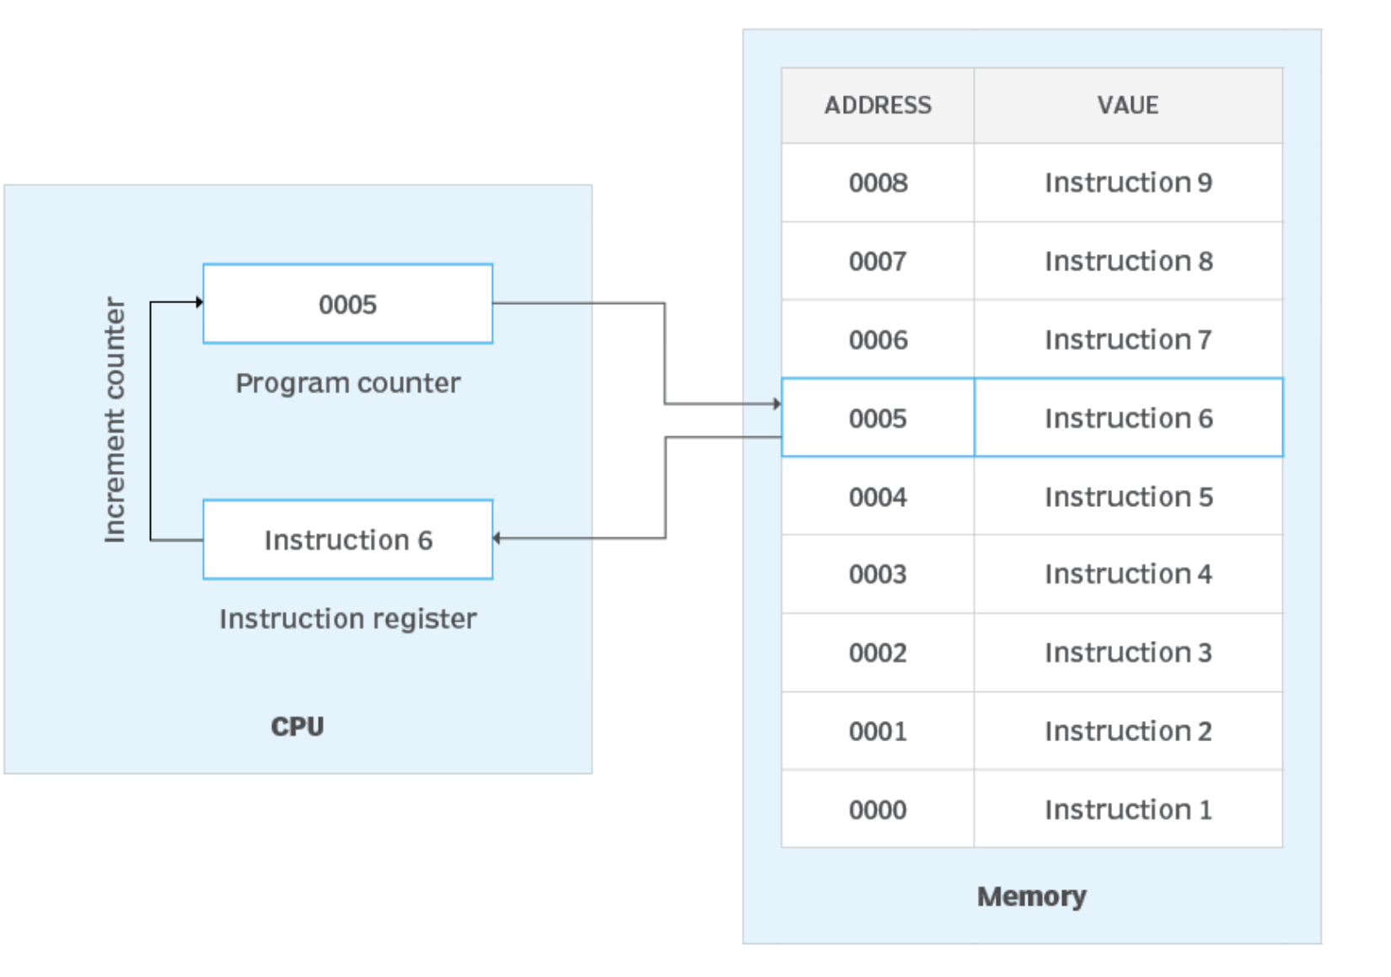
Random Access Memory (RAM)
CPU reads machine code directly from RAM; code can’t be run if it isn’t loaded into RAM
CPU stores an instruction pointer (or program counter) which points to the location in RAM where it’s going to fetch the next instruction.
After executing each instruction, the CPU moves the pointer and repeats.
Fetch-execute cycle
Fetch: read instruction from memory at the current instruction pointer
Execute: run the instruction and then move the instruction pointer
Source: https://www.techtarget.com/whatis/definition/program-counter

Slide 10

Random Access Memory (RAM)
The instruction pointer keeps moving forward, executing machine code in the order in which it has been stored in memory.
Instructions can tell the pointer to jump somewhere else instead depending on a certain condition.
This makes reusable code and conditional logic possible

Slide 11
Memory
The instruction pointer is stored in a register.
Registers: small storage buckets that are extremely fast for the CPU to read and write to.
Each CPU architecture has a fixed set of registers, used for everything
Store temporary values during computation
Configuring the processor

Slide 12
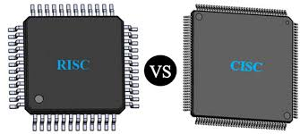




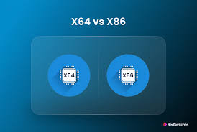
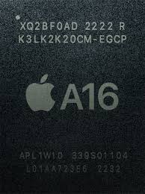
CPU Architectures
CISC
Intel
X86
x64
AMD
x64
RISC
ARM
ARM64
Apple Silicon
RISC-V

Slide 13
CPU Architectures: CISC
Complex Instruction Set Computer
Rich instruction set
High code density
High performance in parallel processing (gaming, video editing)
Compatible with a wide range of software
Intel x86
Used in most personal computers and laptops
Compatible with Windows, Linux, macOS
Powerful consumption, heat generation are high
AMD (x86-64)

Slide 14
CPU Architectures: RISC
Reduced Instruction Set Computer (RISC)
Simple instruction set compared to CISC processors
Faster execution and less power consumption
High performance, energy efficiency
Appropriate for servers, supercomputers, embedded systems
ARM
Advanced RISC Machine
Used in smartphones, tablets, mobile, IoT
High performance and minimal power
Qualcomm, Samsung, Apple all design and produce processors based on Arm

Slide 15
CPU Architectures
When selecting a VM in the cloud, you’ll have the option of CPU platform
ARM
e.g., Ampere Altra
Intel
e.g., Intel Xeon
AMD
e.g., AMD EPYC
Intel AMX
New instruction set designed to accelerate ML and AI workloads

Slide 16
What IS an Operating System?

Slide 17
What is an Operating System?
Memory mgmt
Interrupt handling
Talking with I/O devices
Managing files
Network stack mgmt
A collection of software that runs on your computer and runs all the “basic” stuff.
Abstracts away the different hardware components through an Application Programming Interface (API)

Slide 18
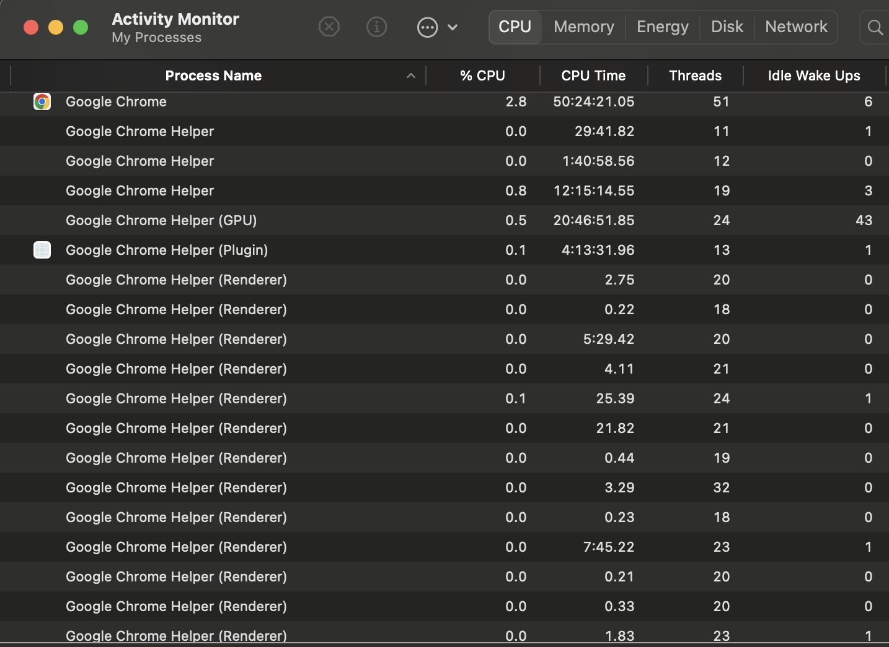
What is a Process?
A computer program is a passive collection of instructions typically stored in a file on disk.
A process is the execution of those instructions after being loaded from the disk into memory.
Several processes may be associated with the same program

Slide 19
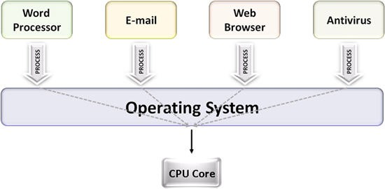
Multitasking
Multitasking is a method to allow multiple processes to share processors and other system resources.
Each CPU (core) executes a single process at a time.
Multitasking allows each processor to switch between tasks that are being executed without having to wait for each task to finish (preemption).
Source: NI Multicore Programming Fundamentals

Slide 20
Multitasking
Depending on the OS implementation, switches could be performed…
…when tasks initiate and wait for completion of input/output operations
…when a task voluntarily yields the CPU
…on hardware interrupts
…when the OS scheduler decides that a process has expired its fair share of CPU time

Slide 21
Time Slicing
A common form of multitasking is provided by CPU's time-sharing that is a method for interleaving the execution of users' processes and threads, and even of independent kernel tasks
Interactive processes are given higher priority with respect to CPU bound processes
Users are immediately assigned computing resources when pressing a key or moving a mouse.
In time-sharing systems, context switches are performed rapidly, which makes it seem like multiple processes are being executed simultaneously on the same processor.
This seemingly-simultaneous execution of multiple processes is called concurrency.

Slide 22
Multitasking
The OS keeps processes separate and allocates the resources they need, so that they are less likely to interfere with each other and cause system failures (e.g., deadlock or thrashing).
The OS may also provide mechanisms for inter-process communication to enable processes to interact in safe and predictable ways.

Slide 23
Processes vs. Threads
Processes are executed by one or more threads
A thread is the smallest sequence of programmed instructions that can be managed independently by an OS scheduler.
The multiple threads of a given process may be executed concurrently (via multithreading capabilities), sharing resources such as memory, while different processes do not share these resources.
The threads of a process share its executable code and the values of its dynamically allocated variables and non-thread-local global variables at any given time.

Slide 24
Processes vs. Services
A service provides a set of coherent and related functions that can be reused and integrated into bigger and more complex applications. The term service is a general abstraction that encompasses several different implementations using different technologies and protocols.
A service is software that:
performs automated tasks
responds to hardware events
listens for data requests from other software
In a user’s OS, these services are often loaded automatically at startup, and run in the background, without user interaction.
Many services are loaded to accomplish different functions. They respond to user keyboard shortcuts, index and optimize the file system, and communicate with other devices on the local network.

Slide 25
Operating system Kernel
The core of the operating system.
When you boot up your computer, the instruction pointer starts at a program somewhere. That program is the kernel
The kernel has near full access to your computer’s memory, peripherals, and other resources, and facilitates running software installed on your computer
These are Userland programs
Linux is just a kernel and needs lots of userland software like shells and display servers to be usable.
The kernel in macOS is called XNU (”X is Not Unix”) and is Unix-like
The modern Windows kernel is the NT kernel

Slide 26
Mode/ Privilege Level/ Ring
Controls what a processor is allowed to do
Modern architectures have at least two options:
Kernel mode
In kernel mode the CPU can execute any supported instruction and access any memory
kernel and drivers run in kernel mode
User mode
In user mode only a subset of instructions is allowed, I/O and memory access is limited, and many CPU settings are locked
applications run in user mode

Slide 27
Mode/ Privilege Level/ Ring
Current privilege level (CPL) can be read from a register called code segment (cs)
CPL is indicated in two bits of the cs register
Four possible rings
Ring 0 is kernel mode
CPL bits == 00
Ring 3 is user mode
CPL bits == 11
ring 1 and 2 are for drivers (only used by older OS’s)

Slide 28
Syscall
Programs run in user mode because they can’t be trusted with full access to the computer
Programs need to be able to access IO, allocate memory, interact with OS…
Software running in user mode asks the OS kernel for help
OS then implements its own security protections to prevent programs from doing bad things
Functions like open, read, fork, exit
abstractions over system calls that ask the OS for help
system call == special procedure that lets a program start a transition from user space to kernel space
goes from program code into OS code
User space to kernel space control transfers are accomplished using a processor feature called software interrupts

Slide 29
Wrapper APIs: Abstracting Away Interrupts
OS APIs are the mechanism for passing data to the OS when triggering a syscall and for the OS to know which specific syscall to execute
Varies by OS and architecture, usually done by placing data in certain registers or on the stack
Variance in how syscalls are called across devices means it would be insane for programmers to implement syscalls themselves for every program
This would also mean OS’s couldn’t change their interrupt handling for fear of breaking every program that was written to use the old system.

Slide 30
Wrapper APIs: Abstracting Away Interrupts
The OS provides an abstraction layer on top of these interrupts
Reusable higher-level library functions that wrap the necessary assembly instructions are provided by libc on Unix-like systems
ntdll.dll on Windows
calls to these functions themselves don’t cause switches to kernel mode
inside the libraries, assembly code does actual transfer control to the kernel
CISC architectures contain multiple instructions for system calls
Intel and AMD: two sets of optimized system call instructions
SYSCALL and SYSENTER
SYSRET and SYSEXIT
RISC architectures
Arch64 (Apple Silicon) only one interrupt instruction for syscalls

Slide 31
Hardware Interrupts
OS schedulers user timer chips to trigger hardware interrupts for multitasking
OS sets the timer chip to trigger an interrupt after some period of time
OS then switches to user mode and jumps to next instruction of the program
When timer elapses, triggers a hardware interrupt to switch to kernel mode and jump to OS code
OS can now save where the program left off, load a different program, and repeat
Preemptive multitasking
Interruption of a process is called preemption

Slide 32
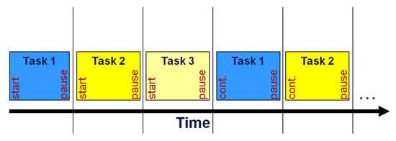
Timeslice Calculation
Timeslice: the duration an OS scheduler allows a process to run before preempting it
Fixed timeslice round-robin scheduling: give every process the same timeslice (e.g. 10ms) and cycle through tasks in order
Or target latency- the ideal longest time for a process to respond
timeslice is calculated by dividing target latency by the total number of tasks
15ms and 10 processes: each process would get 15/10 = 1.5ms to run
Process switching is computationally expensive because it requires saving the entire state of the current program and restoring a different one.
Common to give timeslice duration a lower bound (minimum granularity)
Linux target latency 6ms; minimum granularity of .75ms

Slide 33
Timeslice Calculation
Completely Fair Scheduler
Every time the OS preempts a process, it loads new program’s saved execution context, including its memory environment.
Also prevents programs from accessing each other’s memory
Modern kernels are preemptive kernels
Programmed to allow kernel code itself to be interrupted and scheduled just like userland processes
Notes:
Linux uses a scheduler called Completely Fair Scheduler

Slide 34
LINUX

Slide 35
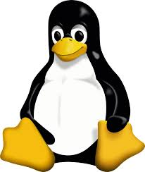
What is Linux?
Linux is the most widely used operating system in the world
Free and open source
Linux kernel:
The set of syscalls and device drivers that are provided as part of your Linux OS
Linux distributions (distros)
Concrete bundling of kernel and related components, including package management, file system layout, shell, etc. all preselected for you

Slide 36
Do We Have TO?

Slide 37
Why?
Broad support
Open Source
Overall ubiquity in server computing
Wide variety of software available
Free to use
Modifiable
Avoid vendor lock-in
Customizable & flexible
Compatible with modern DevOps practices
Customize and configure any task
Enhanced security
High stability
Long-term support

Slide 38
Process IDs
Recall that a process is a program in memory that has all the necessary resources available to run, such as CPU and memory
Linux identifies a process using its process ID, or PID
PID 1 is reserved for the root of the user space process tree.

Slide 39
NaMESPACES
There can be multiple processes with the same PID, in different contexts called namespaces
This happens in containerized setups
e.g., when you’re running your app in Docker or Kubernetes
Part of the illusion of having multiple users or processes running in parallel is the restricted visibility into resources
The way to provide a local view on resources in Linux is via namespaces

Slide 40
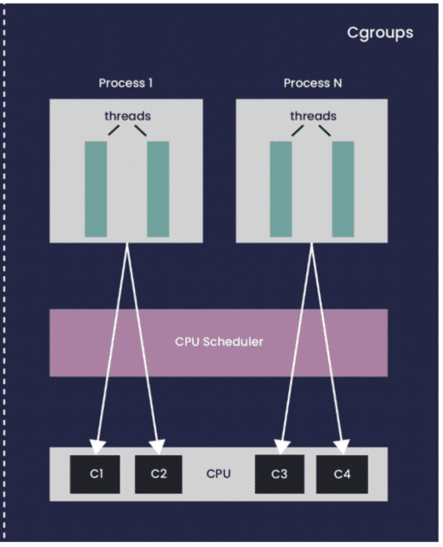
PROCESS Isolation
Process isolation can do many things, but one example is restricting memory consumption so that one process cannot starve other processes.
For example, we give your app 1 GB of RAM to use- if it uses more, it gets out-of-memory error and is killed.
cgroups are the mechanism that provides isolation.
A fully isolated environment gives the appearance that the app is entirely on its own.

Slide 41
Interacting with Linux (from a CLI)
Manual
A human user sits in front of the terminal, interactively typing commands and consuming output
List directories, finding files, looking for content in files
Copying files between directories or to remote machines
Scripting
Automated processing of a series of commands in a special file that the shell interprets for you and in turn executes
Scripts are the basis of many config and install systems

Slide 42
Terminal & Shells
A terminal is a program that provides a textual user interface
Supports reading characters from the keyboard and displaying them on the screen
A shell is a program that runs inside the terminal and acts as a command interpreter.
The shell offers input and output handling via streams, supports variables, has built-in commands you can use, deals with command execution and status, and usually supports interactive usage as well as scripted usage.

Slide 43
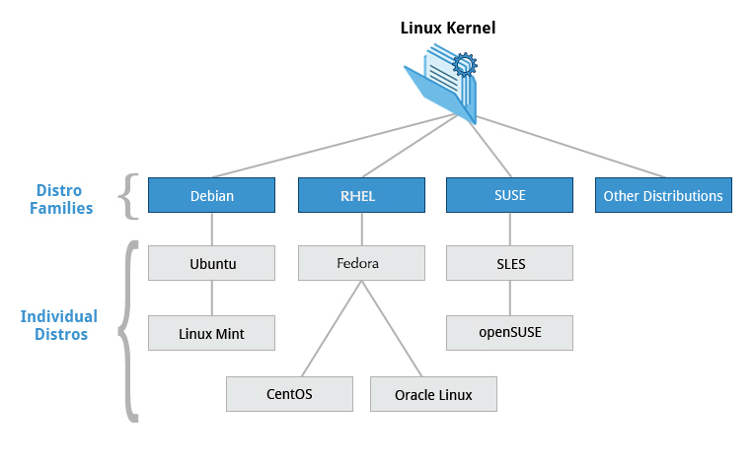
Linux Landscape Overview
Ubuntu
Debian
Red Hat Enterprise Linux (RHEL)
Rocky Linux
Fedora Linux
Arch Linux
Alpine Linux
Amazon Linux

Slide 44
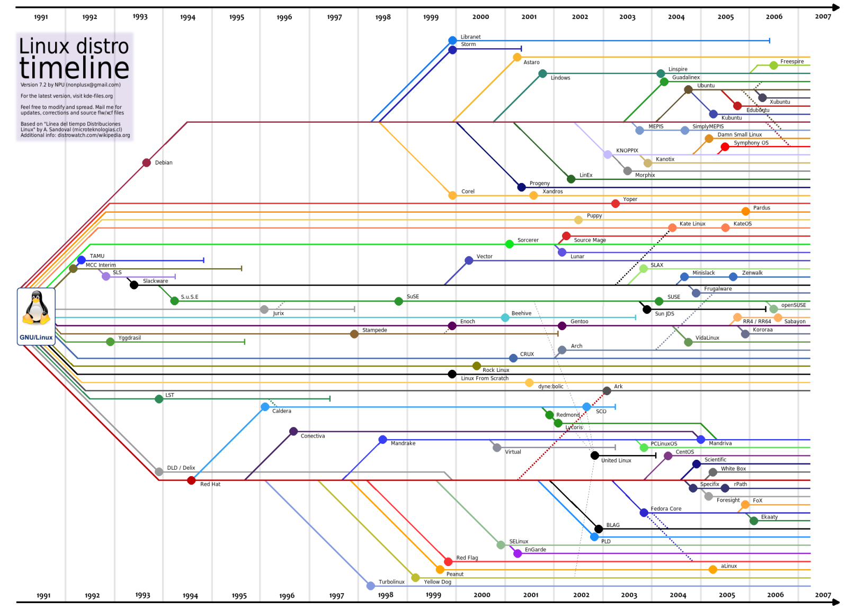
Linux Landscape Cont.

Slide 45
How To Choose a Linux Distribution
Do you need Debian or Red Hat ecosystem?
Are you developing primarily for the cloud, the desktop, or in a container?
Do you need the newest available or stable packages?

Slide 46
Open Source Software (OSS)

Slide 47
What is OSS?
Software released under a license that allows users to
Access
Modify
Distribute
Open collaboration
Free to use* (FSF considers free software to be a subset of open-source software- OSI makes no distinction)
Source code is available

Slide 48
Why Use OSS in Cloud Computing?
Pros?
Cons?

Slide 49
Group Projects
If we have time (if not, we’ll discuss group projects next week!)

Slide 50
REFERENCES
Mattick, L., and Hack Club. 2023. Putting the “You” in CPU. Accessed July 30, 2024. url: https://cpu.land/
Hausenblas, M. 2022. Hausenblas, M. (2022, April). Learning Modern Linux. O’Reilly Media. https://oreil.ly/learning-modern-linux.
Wu, Z., Deng, S., and Wu, J. 2015. Service Computing, Concept, Method, and Technology. Elsevier Inc. https://doi.org/10.1016/C2014-0-01307-X
Garnett, A. 2022. How to Choose a Linux Distribution. DigitalOcean. Accessed Aug 18, 2024. Available: https://www.digitalocean.com/community/conceptual-articles/how-to-choose-a-linux-distribution

Slide 51
LAND ACKNOWLEDGEMENT STATEMENT
We respectfully acknowledge the University of Arizona is on the land and territories of Indigenous peoples. Today, Arizona is home to 22 federally-recognized tribes, with Tucson being home to the O’odham and the Yacqui. Committed to diversity and inclusion, the University strives to build sustainable relationships with sovereign Native Nations and Indigenous communities through education offerings, partnerships, and community service.

